Slide 1
RUNGTA COLLEGE OF DENTAL SCIENCES AND RESEARCH
SPLENOMEGALY AND LYMPHADENOPATHY
DEPARTMENT OF GENERAL MEDICINE

Slide 2
SPECIFIC LEARNING OBJECTIVES
MUST KNOW | NICE TO KNOW | DESIRE TO KNOW
LYMPHADENOPATHY | PHYSICAL EXAMINATION | SPLENECTOMY
DIAGNOSIS | TESTS
SPLENOMEGALY | EVALUATION
CAUSES

Slide 3
CONTENTS
LYMPHADENOPATIES
DIAGNOSTIC APPROACH
HISTORY
PHYSICAL EXAMINATION
DIAGNOSTIC TESTS
SPLENOMEGALY
INTRODUCTION
CAUSES
EVALUATION
SPLENECTOMY
SUMMARY

Slide 5
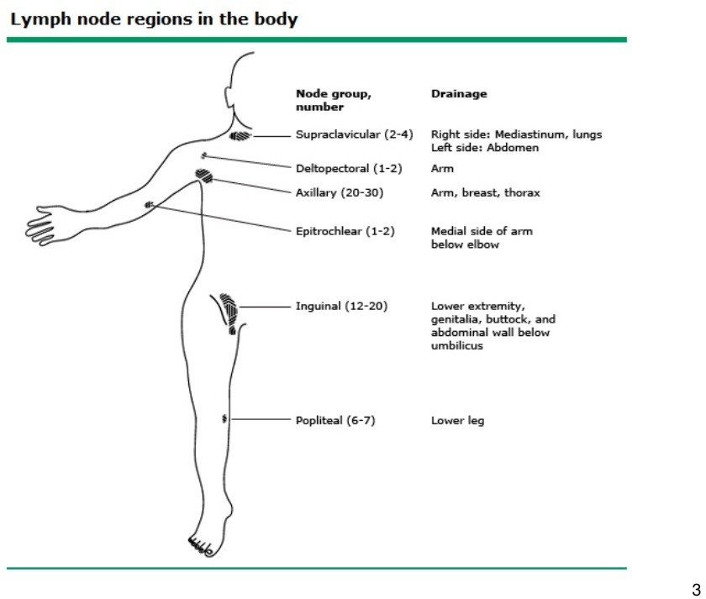

Slide 6
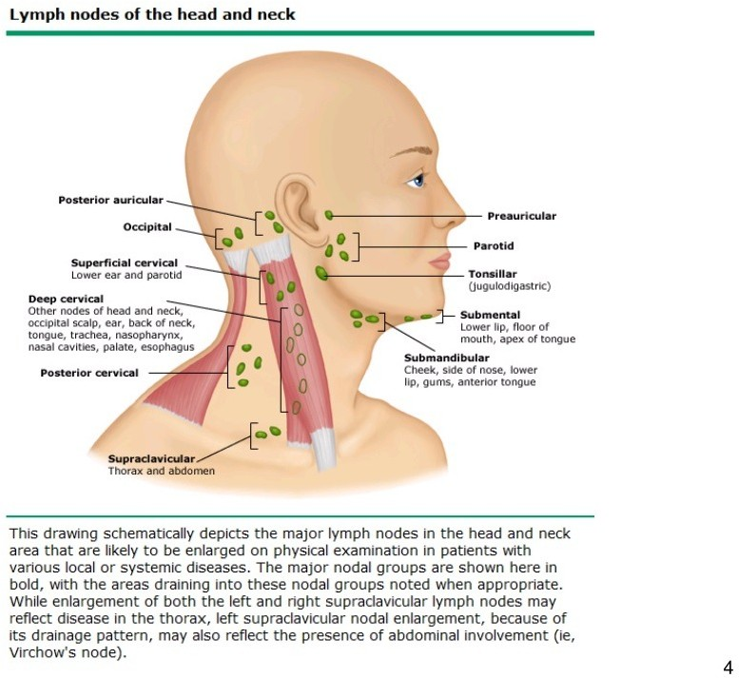

Slide 10
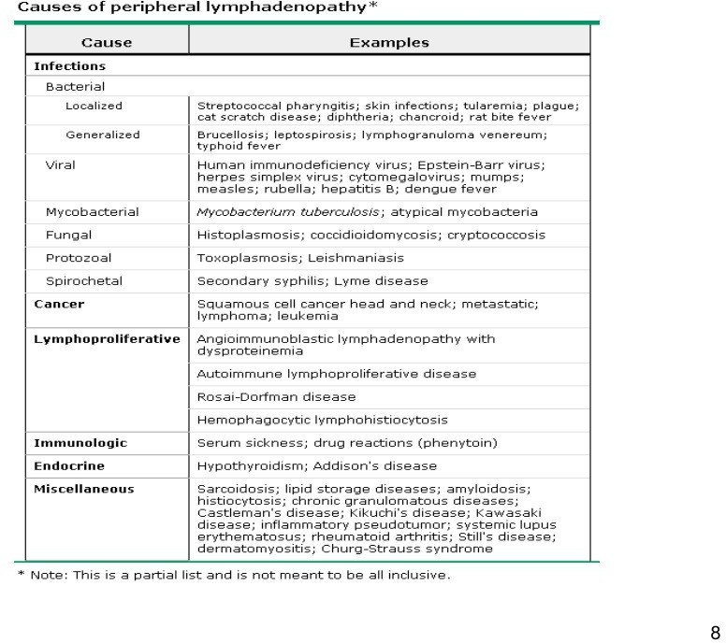

Slide 11
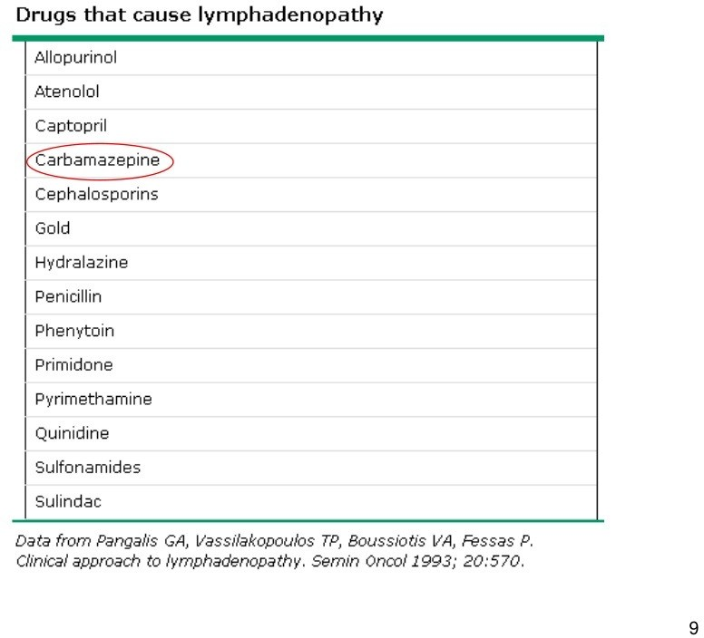

Slide 13
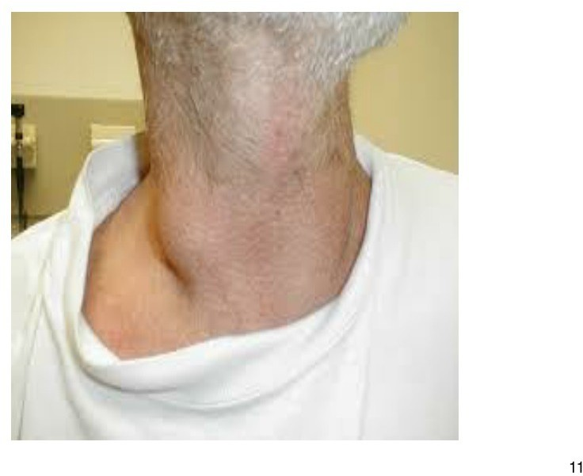

Slide 14
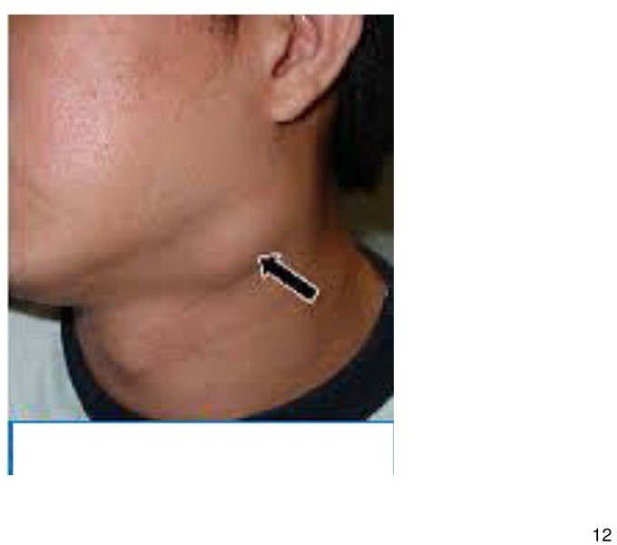

Slide 15
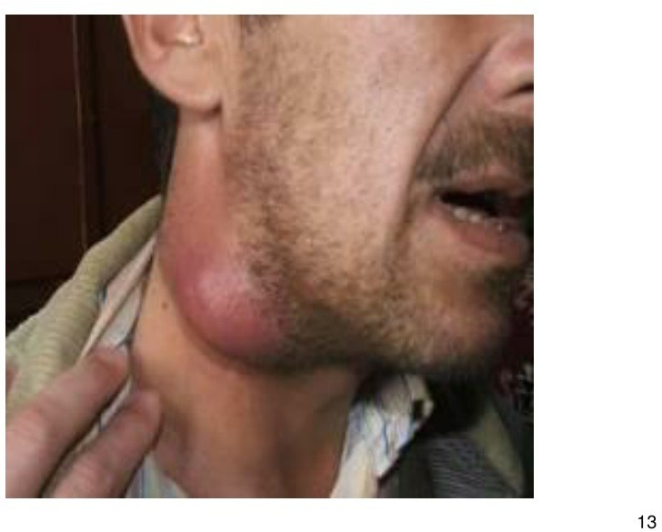

Slide 16
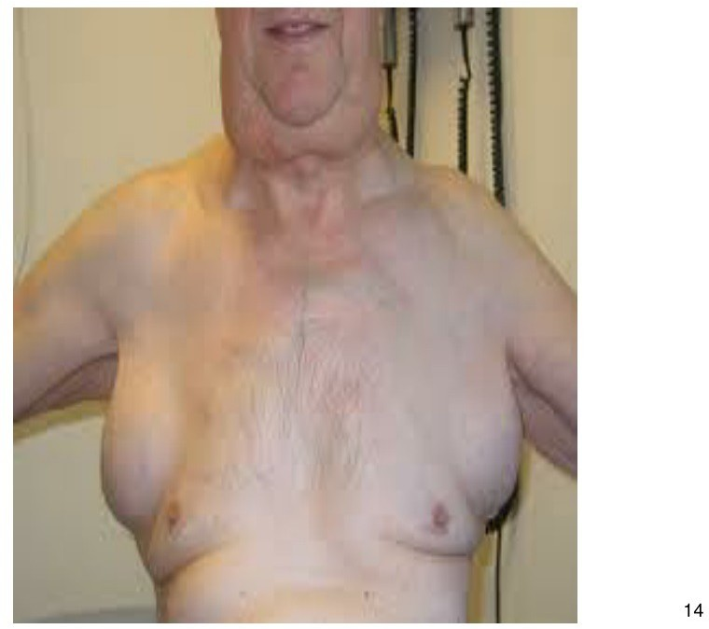

Slide 17
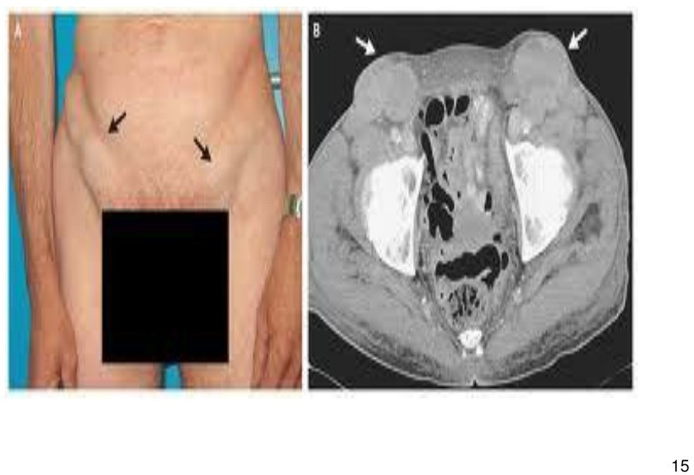

Slide 26
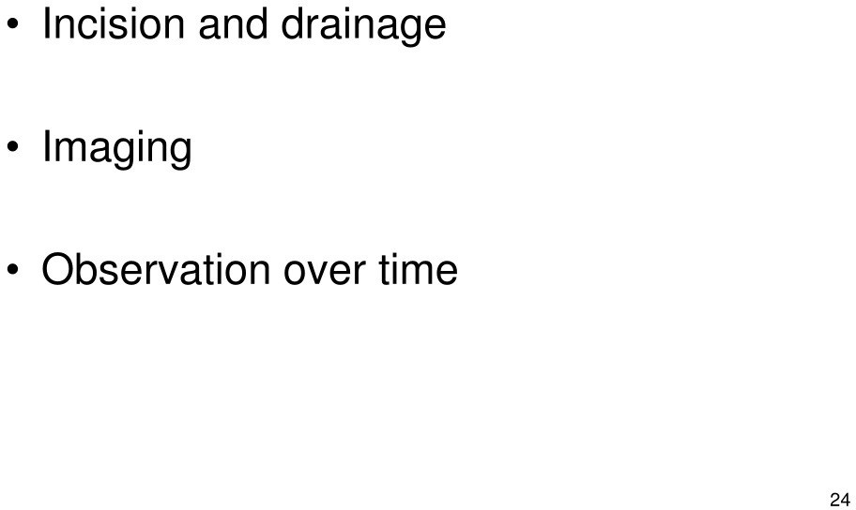

Slide 33
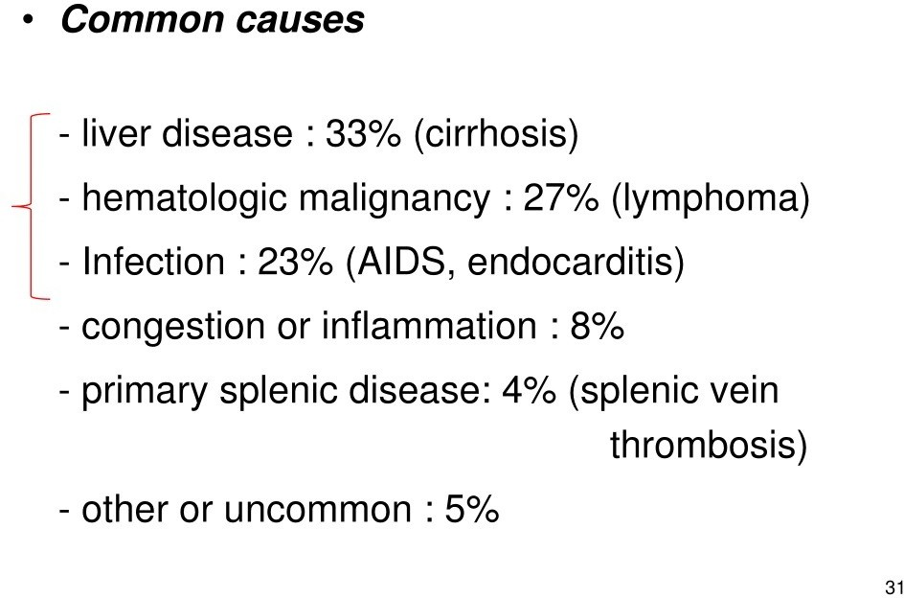

Slide 34
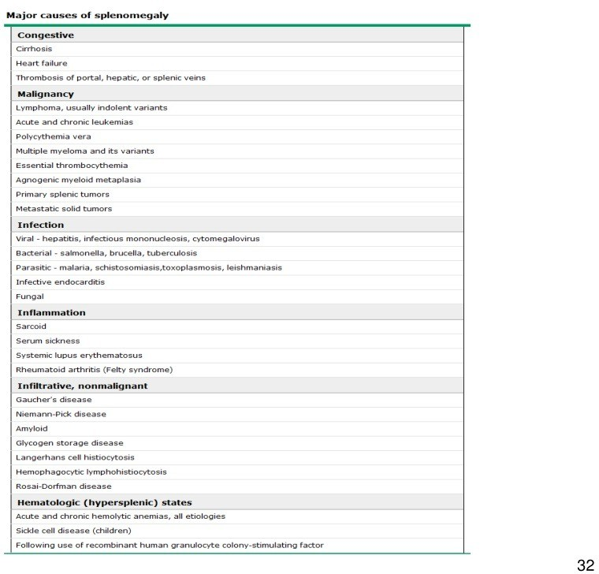

Slide 36
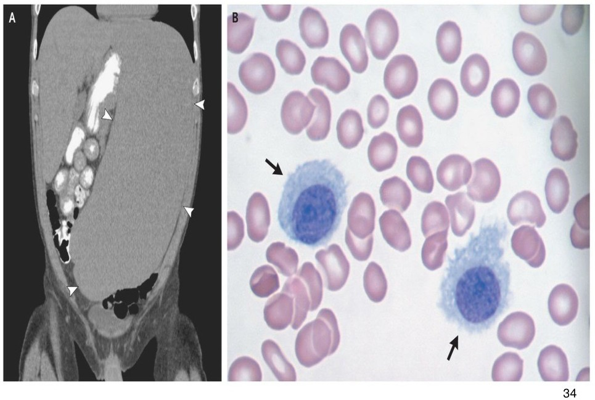

Slide 37
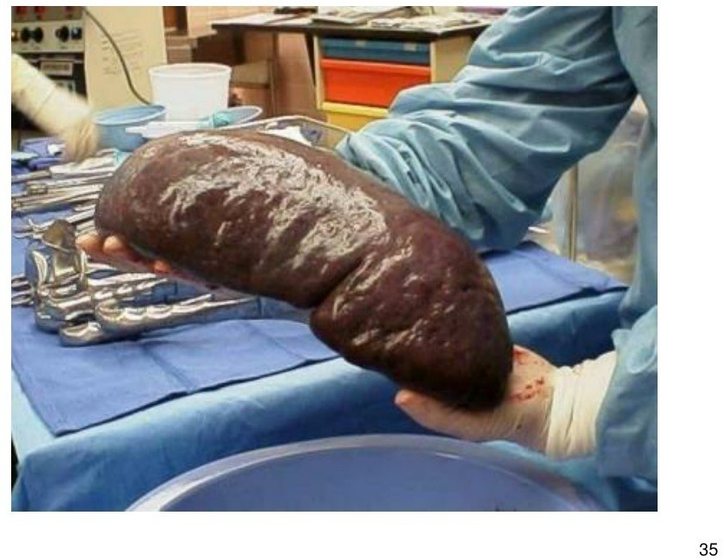

Slide 40
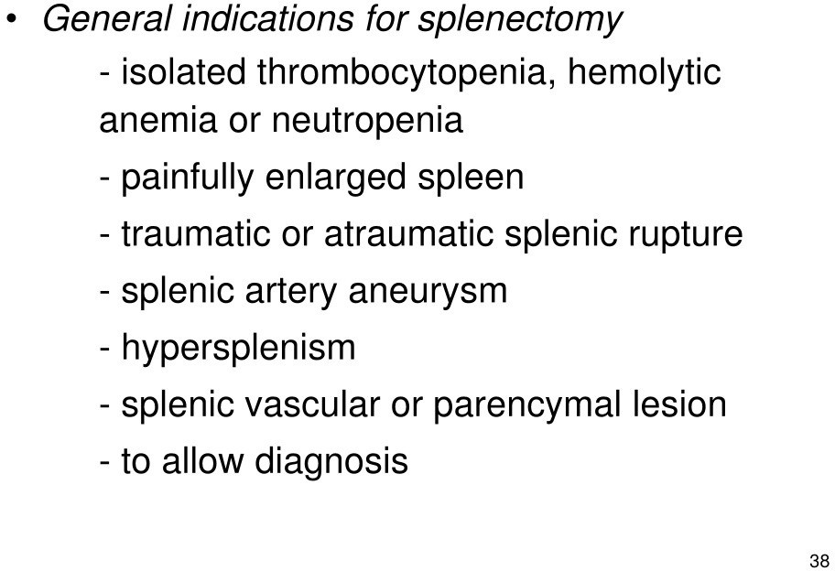

Slide 43
REFERENCES
DAVIDSON’S PRINCIPLES AND PRACTICE OF MEDICINE; 23rd edition
HARRISON’S PRINCIPLE OF INTERNAL MEDICINE; 21ST edition
TEXTBOOK OF CLINICAL MEDICINE by S.N Chugh ;5th edition

Slide 44
QUESTION AND ANSWERS

Slide 45
THANK YOU....

